Slide 1
Data Structures Workshop
Day 17

Slide 2
Workshop Outline
Stacks as Dynamic Arrays
Queues as Dynamic Arrays
Mini-Assessment

Slide 3
Stacks Using Dynamic Arrays

Slide 4
Implementing Stacks as Arrays
We’ve learned about how stacks can be implemented using Linked Lists, but we can also use arrays to implement them.
Must implement them as dynamic arrays (fixed-size arrays may not fit our use case in case the stack were ever to get full).
This way, stack will grow and shrink in capacity as needed.

Slide 5
Stack (Array) Class
Private Data Members:
int *arr → Pointer to Stack Array
int capacity → Stack Array Size
int top → Top Index (We’ll Initialize it at -1 to Show It’s Empty)
Public Data Members:
Constructor
Push(), Pop(), Peek()
isEmpty() & isFull()

Slide 6
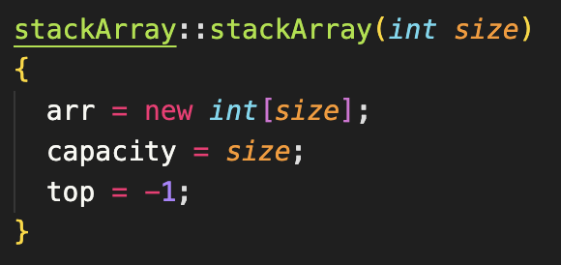
Constructor
Initializes the size
Initializes the array with size
Top is initialized at -1 (to know that it’s empty)

Slide 7
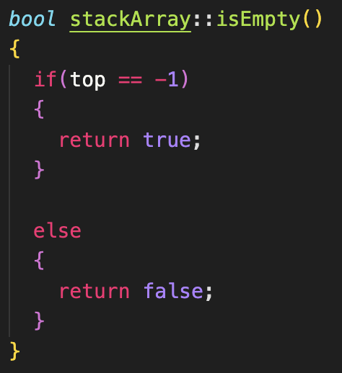
isEmpty()
Checks if top is -1 (if it is, it means the array is empty)

Slide 8
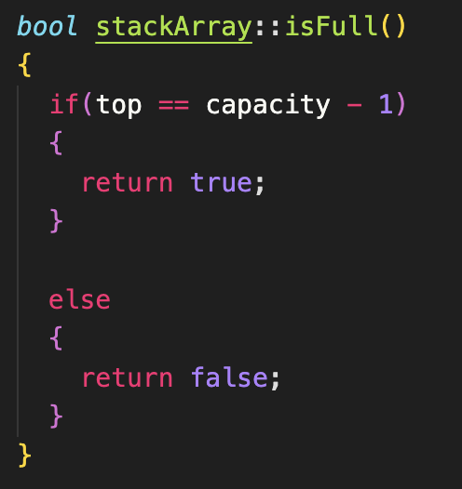
isFull()
Checks if top = capacity - 1, which means array is full (meaning that if we try to add any elements, we’d need to dynamically allocate more size to our stack)

Slide 9
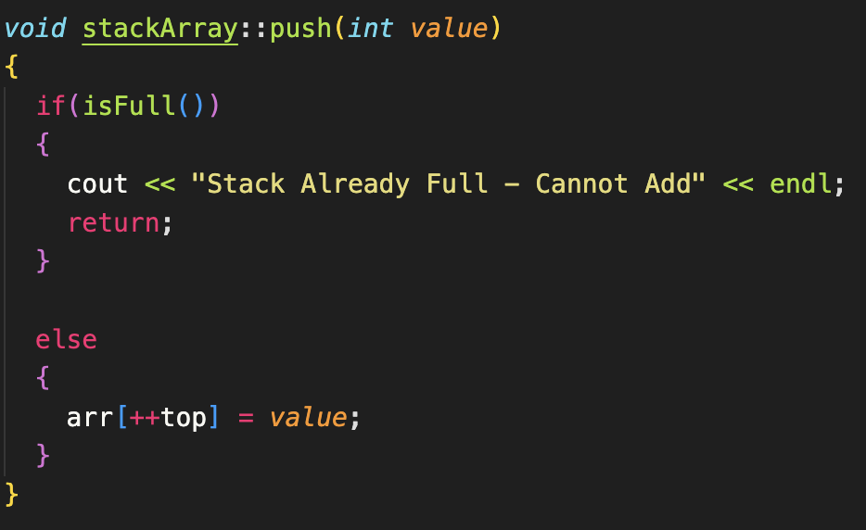
push(int value)
When pushing a value to the stack, first check to see if the array has the right capacity to fit in a new element
If it does, push to the top of the stack (in this case, we’ll increment our top value and store our value there)

Slide 10
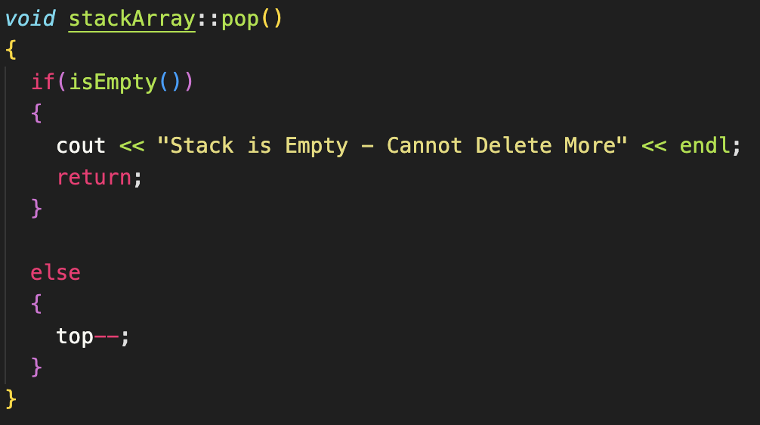
pop()
When popping an element from the stack, first check if the stack is empty or not
If it isn’t empty, we just decrement our top pointer (we’re basically “forgetting” the top value)

Slide 11
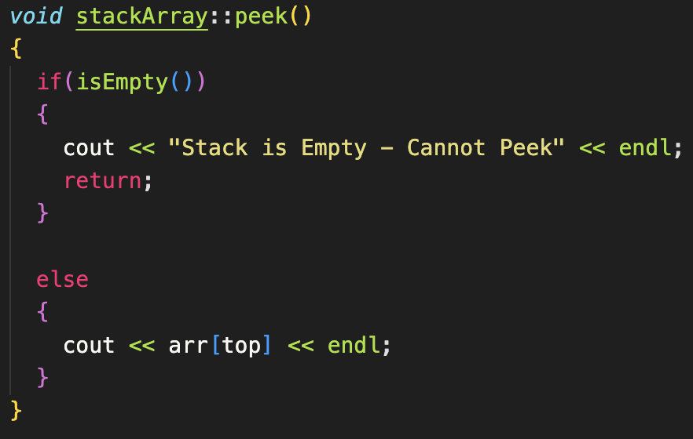
peek()

Slide 12
Queues Using Dynamic Arrays

Slide 13
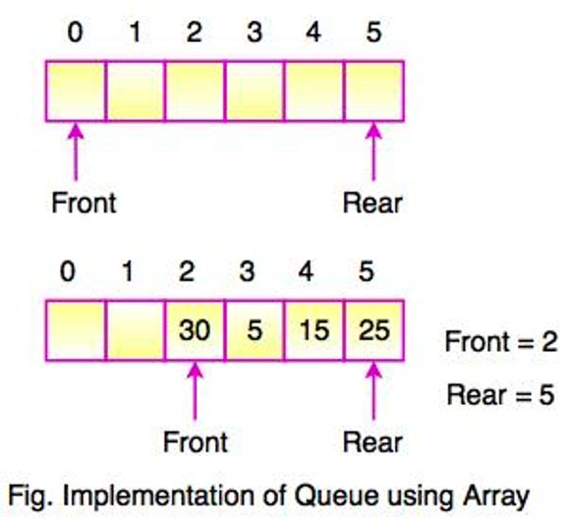
Implementing Queues as Arrays
Very similar approach as our Stack implementation, except now we need both a pointer for the front of our array and the end of our array.
We as well will be using a enqueue and dequeue function instead!

Slide 14
Queue (Array) Class
Private Data Members:
int *arr → Pointer to Queue Array
int capacity → Queue Array Size
int front → Front Index (We’ll Initialize it at -1 to Show It’s Empty)
int end → End Index (Also initialized at -1)
Public Data Members:
Constructor
Enqueue(), Dequeue(), Peek()
isEmpty() & isFull()

Slide 15
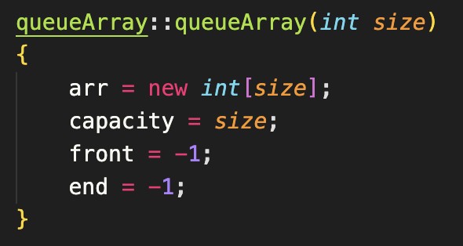
Constructor
Similar to Stack constructor, except now you’re dealing with two pointers in the array, one to hold the front of the queue, and other to hold the end of it

Slide 16
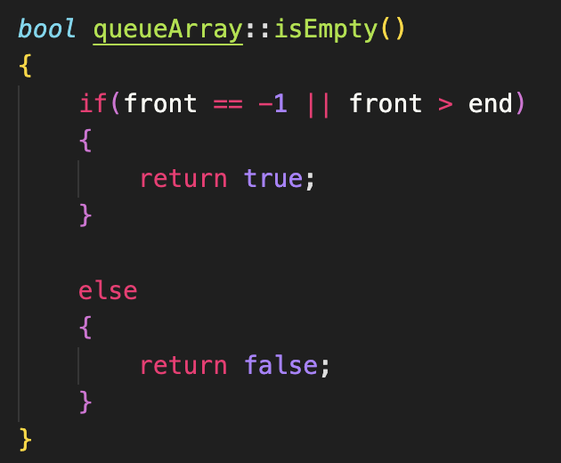
isEmpty()
If front == -1, then that means we haven’t added any element into our queue, therefore it’s empty

Slide 17
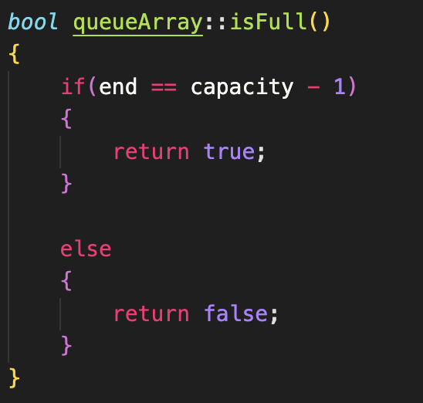
isFull()
Properly checks if our queue is full by checking if end == capacity - 1

Slide 18
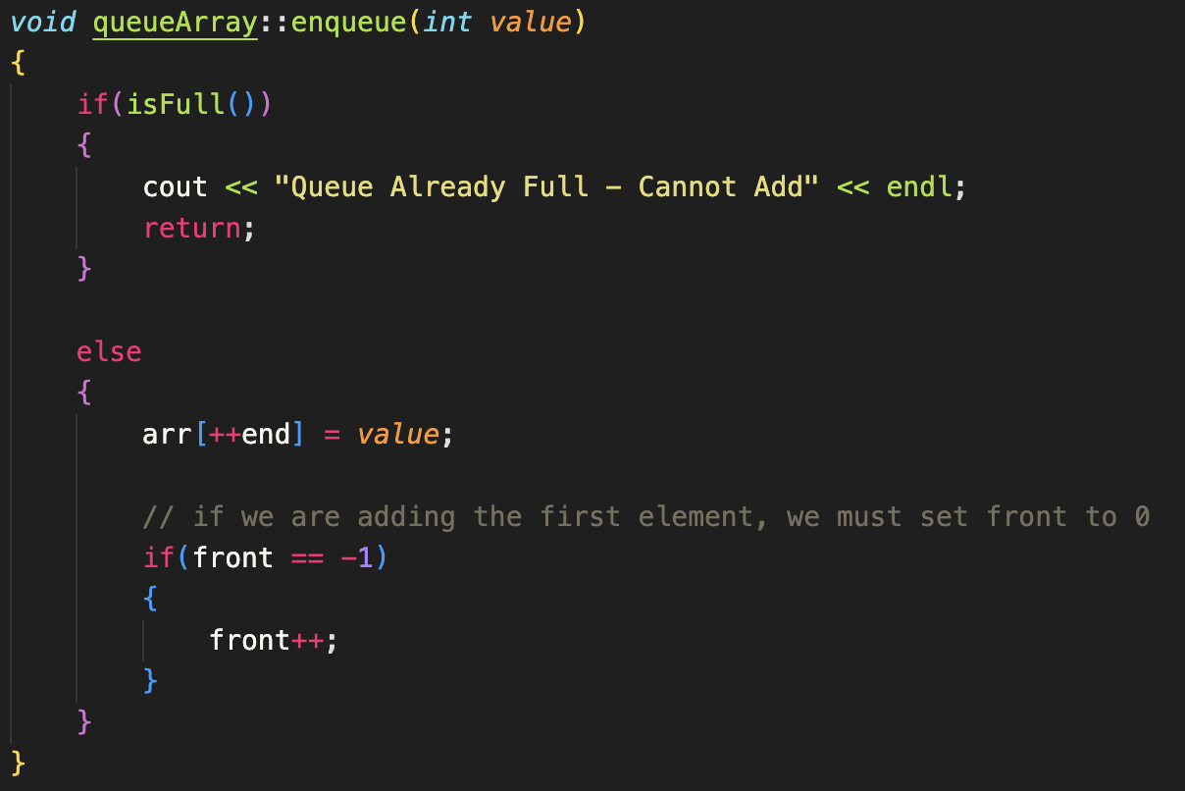
enqueue(int value)
Adds elements to the end of the queue
If the queue is empty when adding an element to it, we set front = 0 (front will be at the beginning of the array), since the queue now exists

Slide 19
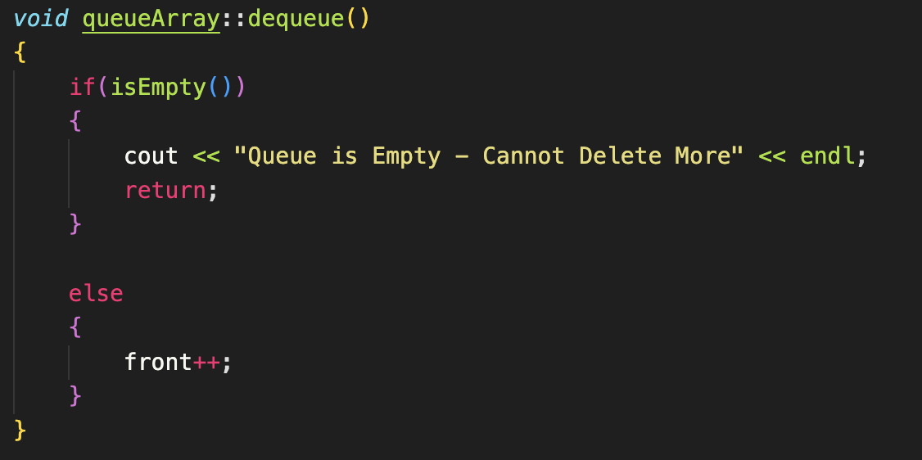
dequeue()
When dequeuing, we remove the first element in the array

Slide 20
Mini-Assessment
Teams will have a mini-assessment uploaded for you guys to take! Use the rest of workshop time for it.
Questions go over one of each exam topic that will be covered on “Exam 2”.
This is just to test where you guys are at in terms of material comprehension so don’t stress, it’s not for a grade.

